Slide 1
Predicting customer cancellation
of cab booking
Sudharshan Reddy Kankara
Charan Teja Somepalli
Santhosh Reddy Agumamidi
Sai Ram Kumar Mamidala
Venkatesh Katragadda

Slide 2
Introduction
Cabs are one of the most used form of transportation
Cab cancellation causes a huge loss to the companies
Can save a lot of money by predicting if a customer will cancel the cab
Took data from Kaggle.com
Online platform for predictive modeling and online competitions.

Slide 3
Data Pre-processing
Data contains 43,000 tuples
It has 20 attributes of which 19 are features and 1 is class variable
Dataset is in .csv format

Slide 4
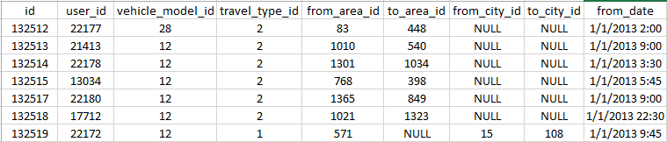
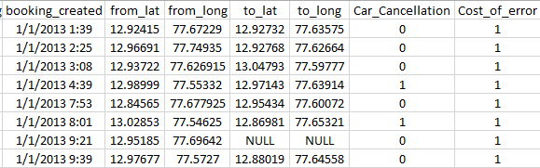
Initial Data

Slide 5
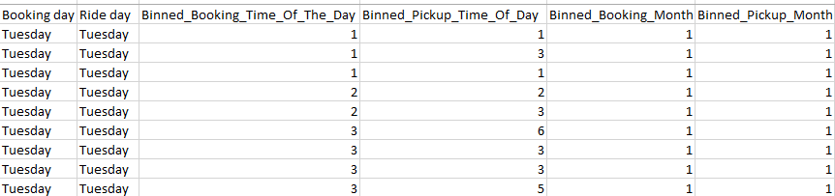
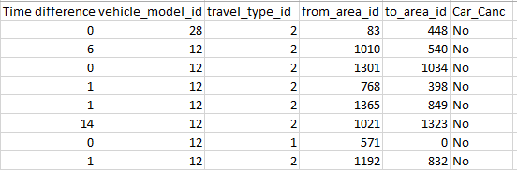
After Pre-processing
Number of attributes reduced from 20 to 12

Slide 6
Algorithms Tested
J-48 (Decision Tree)
Logical Regression
Naïve Bayes
Multilayer Perceptron(Neural Network)
KNN

Slide 7
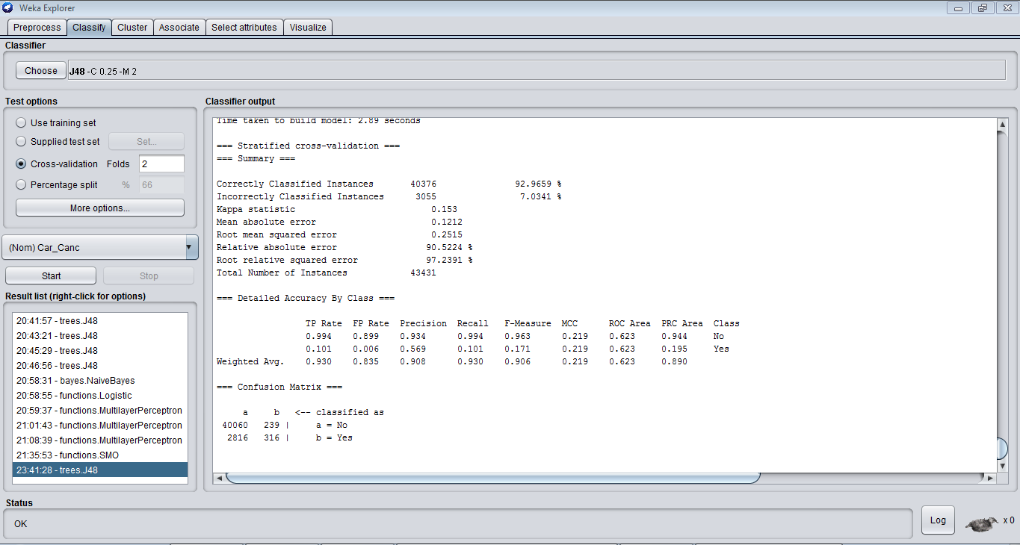
Decision Tree

Slide 8
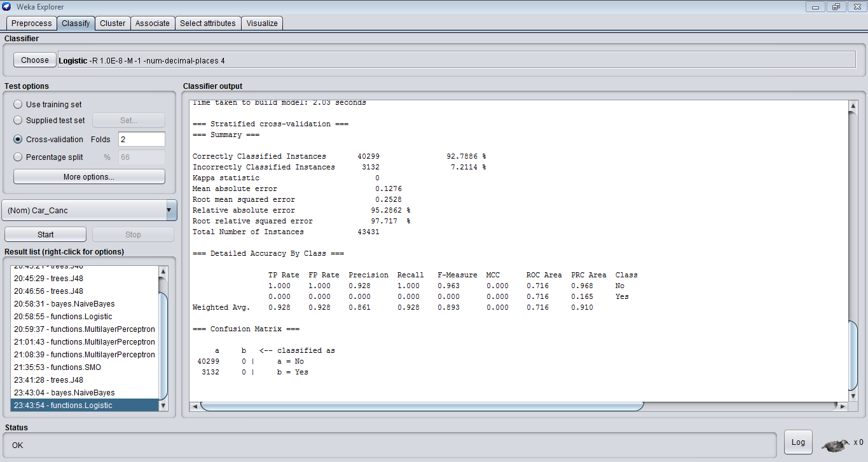
Logistic Regression

Slide 9
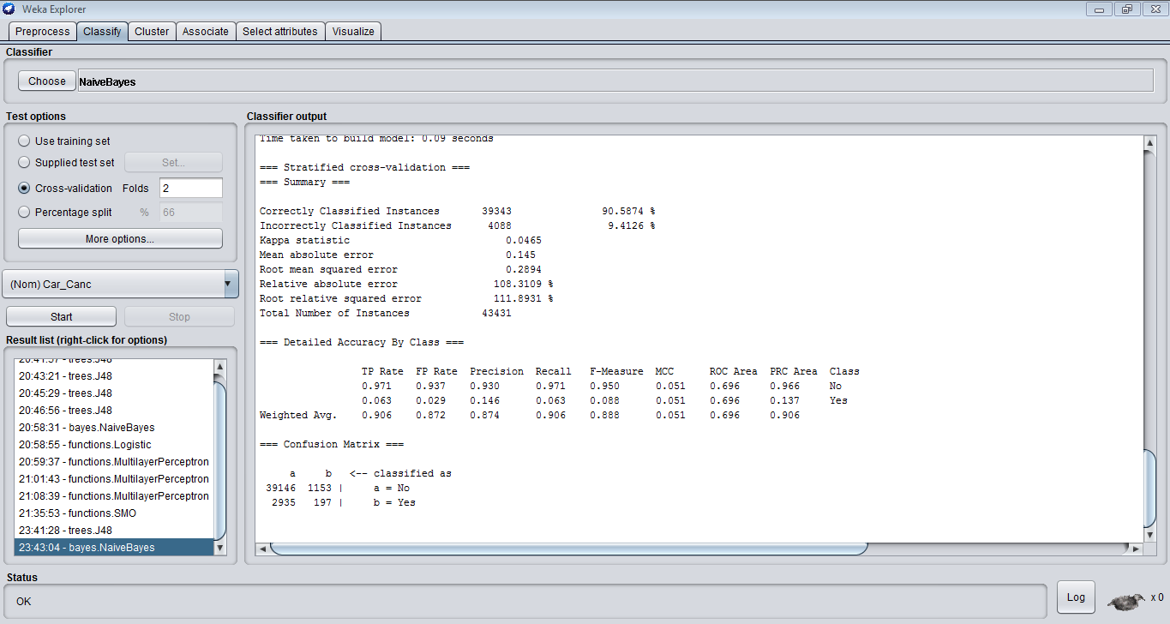
Naïve Bayes

Slide 10
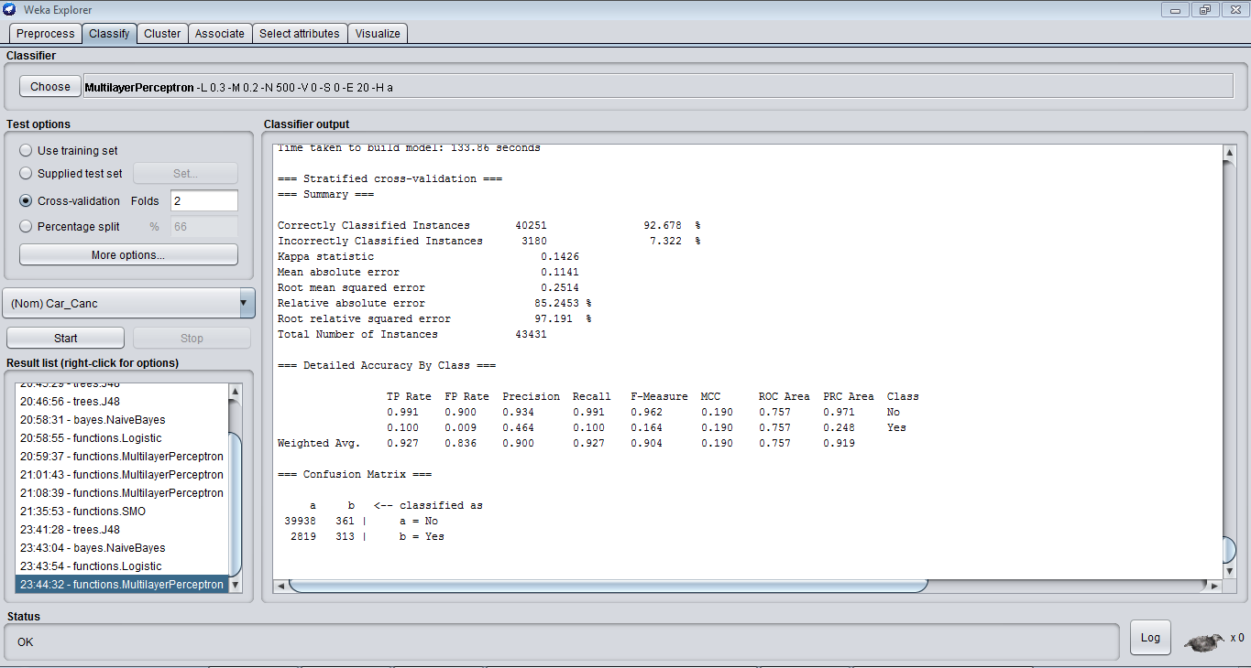
Neural Network

Slide 11
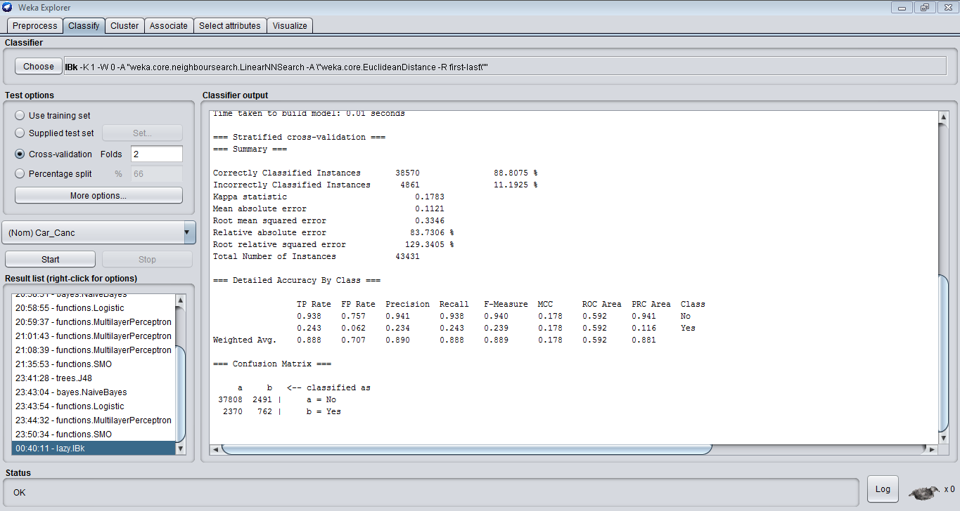
KNN

Slide 12
Points to be noted
Accuracy is high for decision tree
It is medium for Naïve bayes and KNN
Logistic regression has no effect on data
KNN is highly beneficial for the company

Slide 13
Future Progress
We will try to implement few more algorithms on the dataset and try to obtain the optimal results.

Slide 14
References
Predicting-customer-cancellation-cab-bookings-yourcabscom – Blog galitshmueli.
(http://www.galitshmueli.com/data-mining-project/predicting-customer-cancellation-cab-bookings-yourcabscom)
Weka – Data Mining Software in Java:
http://www.cs.waikato.ac.nz/ml/weka/
https://inclass.kaggle.com/c/predicting-cab-booking-cancellations/data

Slide 15
Thank You

